Slide 1
Introduction to Options
Amherst College Quantitative Trading Club, Feb. 13th 2020

Slide 2
What is an Option?
The right to take an action
Owning an option gives you that right
Selling an option means you sold your rights to a counterparty, so you are left with an obligation to fulfill those rights
Call - buy, put - sell
Usually covers a “round lot” aka 100 shares of something

Slide 3
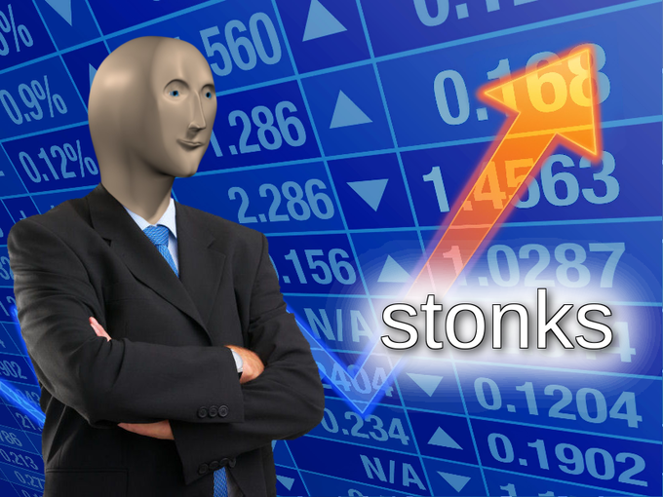
Why Options?
Insurance aka hedging
Smoother execution (liquidity, price slippage, etc.)
BETS

Slide 4
Basic Market Structure
Listed on the CBOE (stocks and indices), CME & CBOT (futures)
60% close/cover
10% exercise
30% WORTHLESS, -100%
Equity options are American-style; index options are European-style
Designated market maker, very little liquidity risk
OCC as counterparty, practically zero default risk
OCC -> clearing member -> broker -> you
Trivia: 9am-4pm NY time; 830am-302pm Chicago time
OTC markets exist, mostly for European style, more expensive

Slide 5
Pricing Factors for Options
Price of underlying asset, S
Strike price of option, X
Time to maturity, T - t
Variance of continuously compounded returns of the underlying, 𝜎^2
Continuous compound: exp(r1 * r2 * … rn)
Riskless interest rate, r
Present value of dividends from t to T, D
These affect the intrinsic value, which may not align with the price you pay

Slide 6
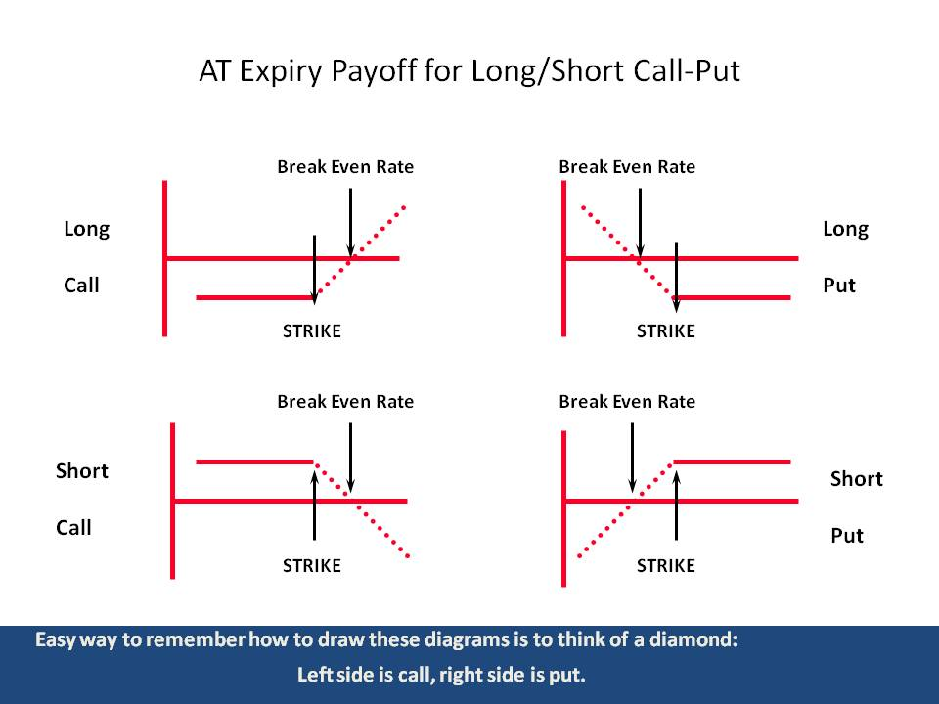
Source: QuantLab

Slide 7
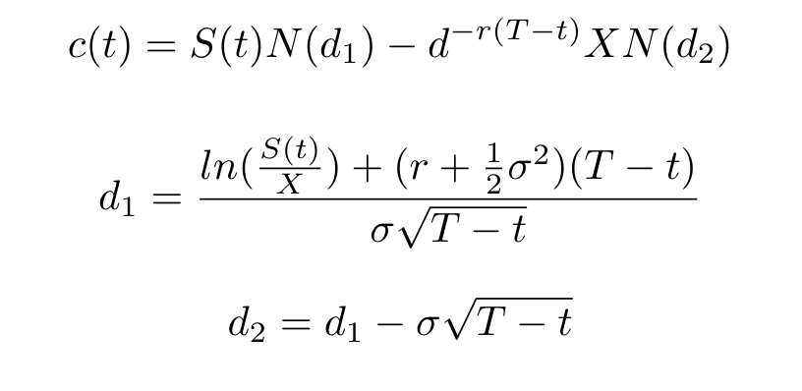
Basic Black Scholes

Slide 8
Black Scholes Assumptions
Derived from a bond and a stock
No transaction costs or taxes
All securities are perfectly divisible (could buy half a stock)
Stock pays no dividends
Security trading is continuous in time
You could trade at t1 and t2 ⇒ You can trade at any t satisfying t1 <= t <= t2
Both the bond and the stock could be sold short with NO restrictions
Riskless interest rate r is constant
This is (hopefully) obvious useless

Slide 9
So...How to Price?
DCF does NOT work (you don’t know the discount rate since the variable is path-dependent)
Numerical Monte Carlo simulation (relies on risk-neutral valuation i.e. price = discounted expected value)
Lattice/Binomial (discrete time model, allows for early exercise)
If anybody actually knows they would have a Nobel Prize now
Notes:
https://en.wikipedia.org/wiki/Monte_Carlo_methods_for_option_pricing

Slide 10
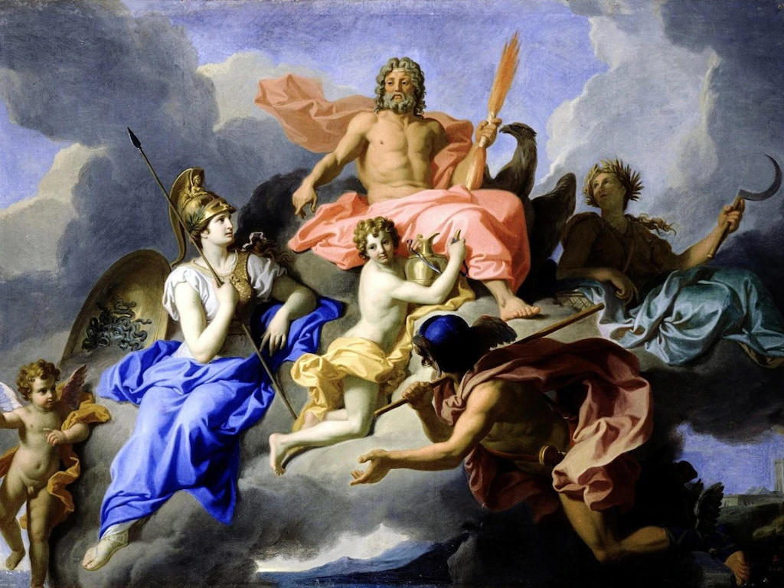
Next Time...
Greeks
Put-Call Parity
Trading
Experience talk (not by me)
Market views and opinions
More Greeks

